Slide 1

Encore-flexible Heatpump
May 2022
Shahla Huseynova

Slide 2
Sensible heat storage
Water storage-input parameters
Water storage as a flexibility to heat pump to increase the source temperature and thus COP
Efficiency = 100 % for now
Max, min power
Capacity per volume = 50 * 1e-3 MWh/m3
Volume = 1000 m3
Max storage capacity = 50 MWh
Lifetime = 25 years
Temperature = 368 K (95C)
Min storage level = 5 MWh
Max storage level = 0.95* Max storage capacity

Slide 3
Encore
First approach
HP sink temp =80-170
Water source
Compressor
HP source T
25-75 ⁰C
Condenser
Water storage
Evaporator
COP
Exp. valve
Factory

Slide 4
Encore
Coil option
HP sink temp =80-170
Water source
Compressor
HP source T
25-75 ⁰C
Condenser
Water
storage
Evaporator
COP
Exp. valve
Factory

Slide 5
Encore
Condenser side
HP sink temp =80-170
25-75 ⁰C
Water source
Compressor
Evaporator
Condenser
Water
storage
COP
Exp. valve
Factory
Outlet is HP source, inlet flow is HP sink?

Slide 6

Modification RDB
-Hot water circuit feeds
in a closed loop into
the storage. A pump in the hot water circuit can control the flow on that side
To ambient or return to process
Compressor
Evaporator
Condenser
COP
Exp. valve
Process
Source water
Hot water
Thermal storage
Return water
Process Waste Heat
25-75 ⁰C
Idea Recoy: use thermal storage to increase temperature of waste heat stream that goes into evaporator

Slide 7
Modification RDB
-Hot water circuit feeds
in a closed loop into
the storage. A pump in the hot water circuit can control the flow on that side . Now Equal to slide 1
Encore
To ambient or return to process
Compressor
Thermal
storage
Condenser
Evaporator
COP
Exp. valve
Fresh water
Process
Source water
Process Waste Heat
25-75 ⁰C
Idea Recoy: use thermal storage to increase temperature of waste heat stream that goes into evaporator

Slide 8
Encore
With stratified tank
To ambient or return to process
Compressor
Thermal
storage
55
95
Condenser
Evaporator
95
COP
Exp. valve
Fresh water
T=Tsink
MW=Y (max heat output)
Tsink=125-170
Process
MW=Y-X
MW=X
Feed water
15 C
T=Tsink
Process Waste Heat
25-75
Idea Recoy: use thermal storage to increase temperature of waste heat stream that goes into evaporator

Slide 9
Encore
Process flow and modelling approach combined
To ambient or return to process
Compressor
Thermal
storage
55
95
Condenser
Evaporator
95
COP
Exp. valve
Fresh water
T=Tsink
MW=Y (max heat output)
Tsink=125-170
Process
MW=Y-X
MW=X
T=Tsink
Process Waste Heat
25-75

Slide 10
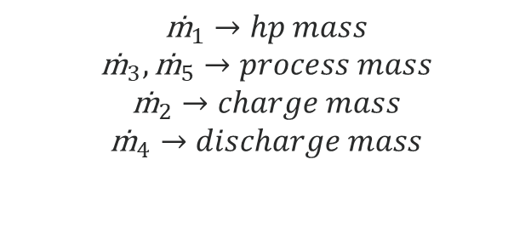
Encore
Simplification for the Modeling approach
140 C
10 kg/s
6 MW
2
1
3
Storage
Heat pump
52kg/s
Process
42 kg/s
31MW
140 C
140C
6
MW
60 C
$${\text{ṁ}}_{1}→hp mass$$
$${\text{ṁ}}_{3},{\text{ṁ}}_{5}→process mass$$
$${\text{ṁ}}_{2}→charge mass$$
$${\text{ṁ}}_{4}→discharge mass$$
95C
13 kg/s
5
4
42 kg/s
6 MW
13*95 + 60*42= (13+42)*T
T=68

Slide 11
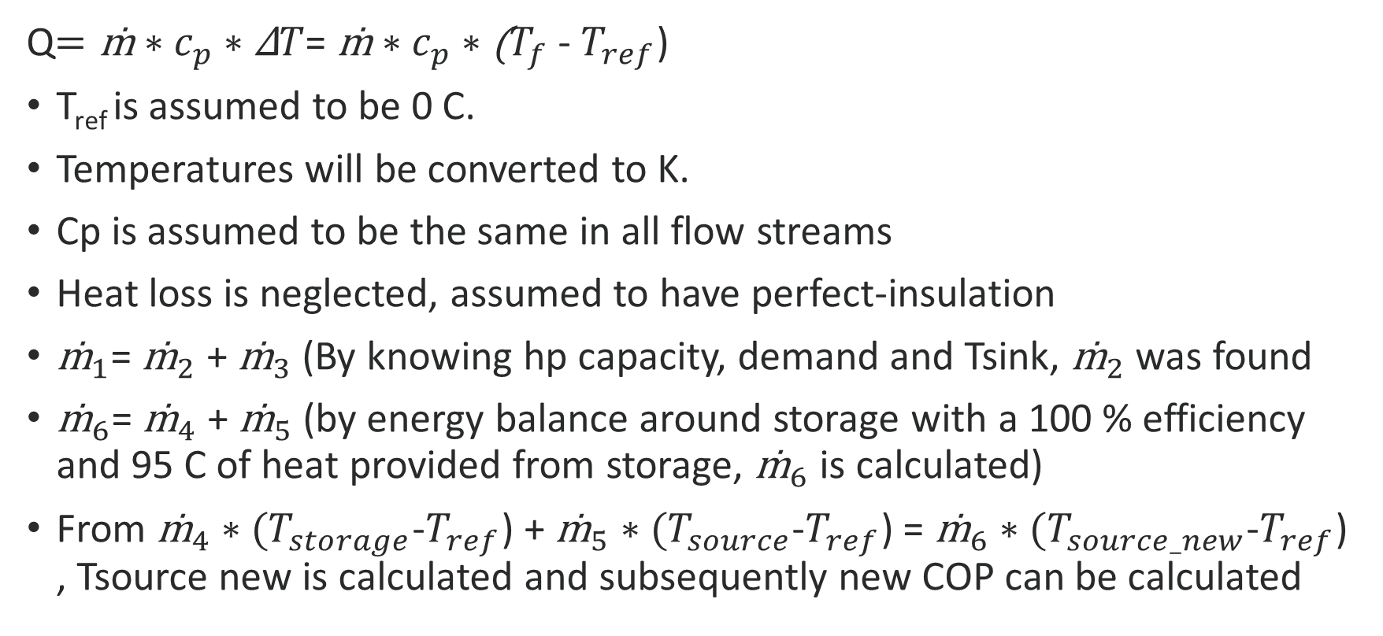
Encore
New Tsource and COP calculation
Q$=\text{ṁ}∗c_{p}∗\text{Δ}T$= ṁ$∗c_{p}∗\text{(}T_{f}$ - $T_{ref}$)
T_{ref} is assumed to be 0 C.
Temperatures will be converted to K.
Cp is assumed to be the same in all flow streams
Heat loss is neglected, assumed to have perfect-insulation
${\text{ṁ}}_{1}$= ${\text{ṁ}}_{2}$ + ${\text{ṁ}}_{3}$(By knowing hp capacity, demand and Tsink, ${\text{ṁ}}_{2}$ was found
${\text{ṁ}}_{6}$= ${\text{ṁ}}_{4}$ + ${\text{ṁ}}_{5}$ (by energy balance around storage with a 100 % efficiency and 95 C of heat provided from storage, ${\text{ṁ}}_{6}$ is calculated)
From ${\text{ṁ}}_{4}∗(T_{storage}$-$T_{ref}$) + ${\text{ṁ}}_{5}∗(T_{source}$-$T_{ref}$) = ${\text{ṁ}}_{6}∗(T_{source_new}$-$T_{ref}$) , Tsource new is calculated and subsequently new COP can be calculated

Slide 12
Encore
Steps for heat pump and storage interaction
1. Follows this heuristic logic based on given price:
- If electricity price is low --> Heatpump at full power, and charge the storage
- If electricity price is low --> Tsource is lower than the median temperature, discharge the storage??
- If electricity price is high --> Discharge the heat storage, and increase Tsource, which will increase COP
2. Cost calculation of heat production
- Costs are based on electricity consumption of heat pump
- Energy is procured in day-ahead market, assuming that heat pump runs baseload without heat storage
- Electricity cons. for the new system with storage is calculated in the simulation case.
- Imbalance volumes are calculated per 15 mins
- This imbalance volume is charged on the imbalance market (POS price if consumed less, NEG price if consumed more)

Slide 13
Encore
Storage functions in the model
Water storage is charged to its maximum storage level
Water storage is discharged until minimum storage level.
Storage level is set to new level after charging/discharging or stand-by case.
Volume can be optimized
Storage Capex: 10 Euro/kWh

Slide 14
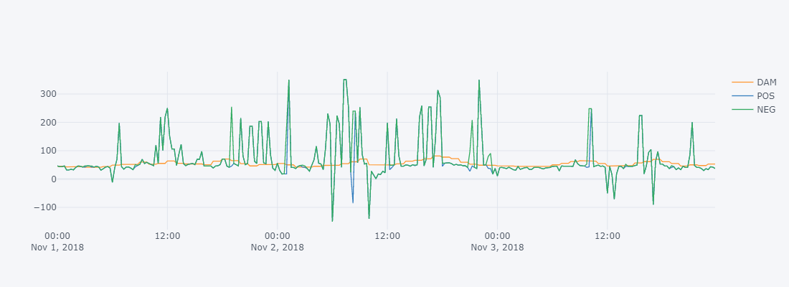
Encore
Imbalance prices vs day-ahead prices
November 2018 electricity prices

Slide 15
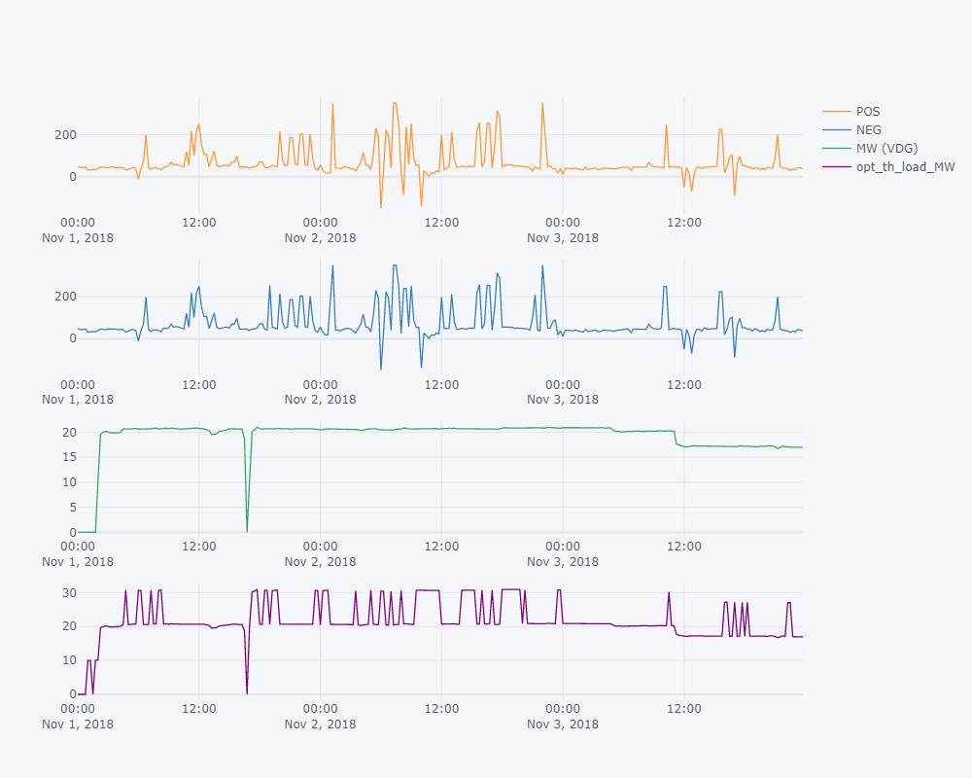
Dynamics of the model
The results of 2 days

Slide 16
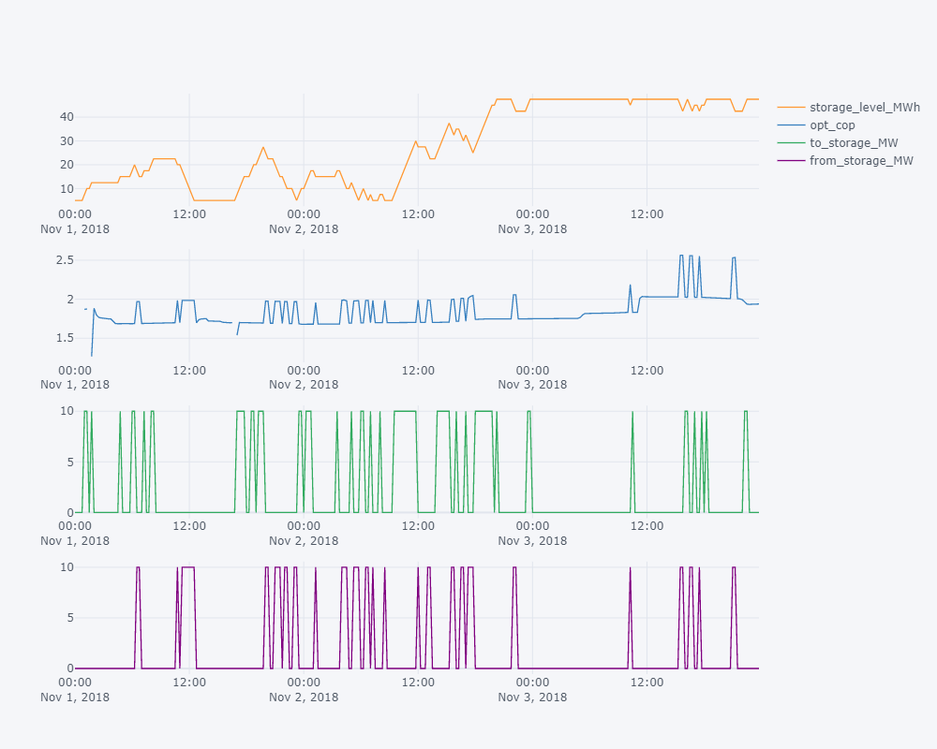
Dynamics of the model
When the storage is discharged, COP increase
To storage power also aligns with the storage level
Total saving is 2.3% per month

Slide 17
Encore
Appendix

Slide 18
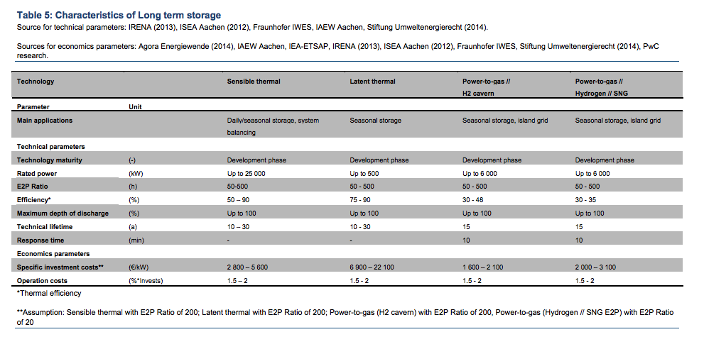
Heat Storage
Vergelijking met andere energie opslag technologieën
(World Energy Council, 2016)

Slide 19
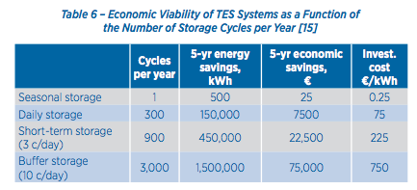
Heat Storage
Storage duration vs. Cost
The longer the storage period, the lower the investment costs (€ / kWh) must be to make it economically interesting

Slide 20
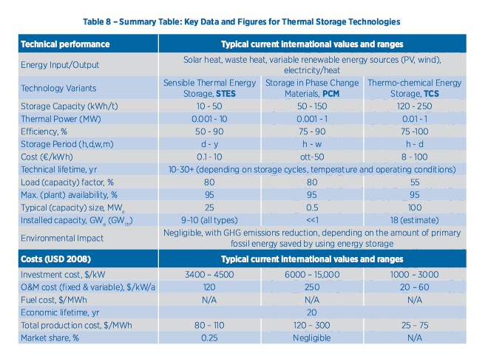
Heat Storage
Comparison heat storage technologies
(IEA-ETSAP & ARENA, 2012)

